Slide 1


CSE 470 – Waterfall Model
BRAC University

Slide 2


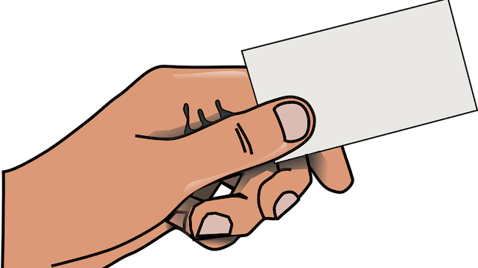
New Project
Team Lead

Slide 3


Model B
Model C
Model A

Slide 4



Small Customer Base
We know What we Want

Slide 5

Waterfall Model
A sequential methodology for software project management.

Slide 6
Requirement Analysis
Design
Coding
Testing
Deployment
Maintenance

Slide 7
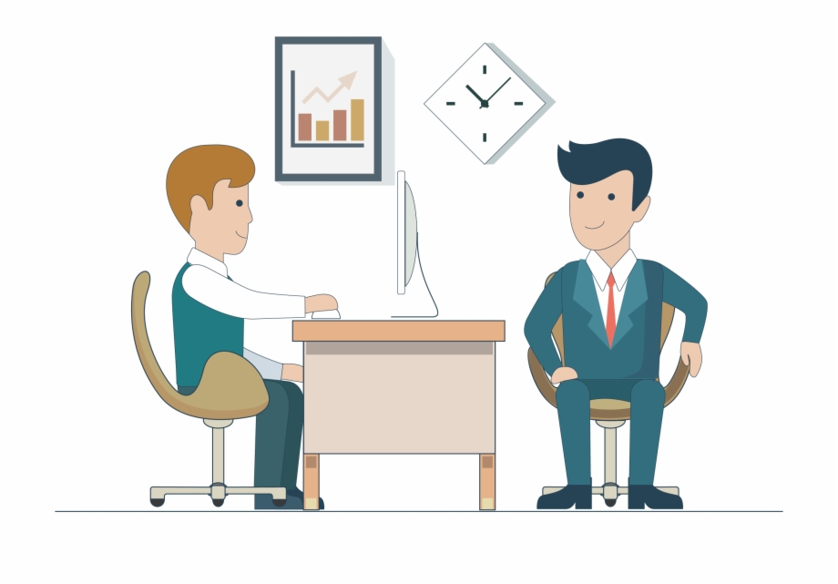

Requirement Collection
It starts with the concept about what the customer wants to do.
Client Meeting
Collect Requirements

Slide 8


Address the problem
Identify the feasible and infeasible requirements
Identify how the software will meet the customer requirements
APPROVED

Slide 9
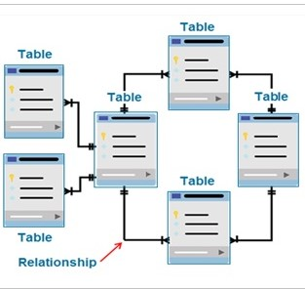
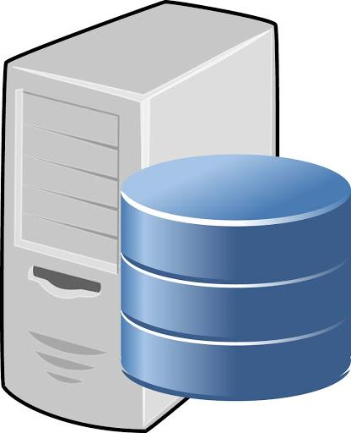
Design
Creates the logical and physical design of the software project
APPROVED

Slide 10

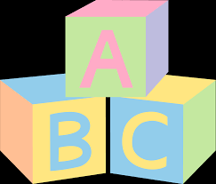
Coding
We need to build it first
Coding can not start until design is fixed properly
Starts with converting the design in actual running software.
The design is spilt into blocks, and blocks are converted to code modules on after another.
APPROVED

Slide 11
Testing
Check the software against the requirements set at Requirement Analysis Phase.
In case of any problem, that problem is fixed in the code.
It works perfectly !!
That does not work !!
APPROVED

Slide 12

Deployment and Maintenance
The software goes in production in actual information technology environment, specially goes to user environment.
Step by step deployment and maintenance performed
If anything goes wrong here will be maintained and resolved by the team.
Feedback may also be collected
Location A
Location B
Location C
Location D

Slide 13
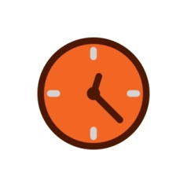

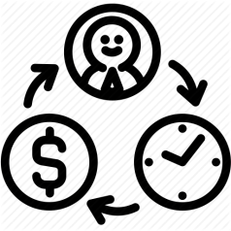
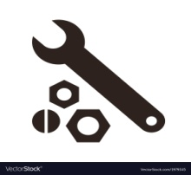
When to choose Waterfall Model
Requirements are well known
Small scale and short term project
Resources are available and trained
Technological tools required are not dynamic, instead are stable

Slide 14

Advantages & Disadvantages
Simple to Use and Easy
Stages go one by one, so sudden changes can not create confusions
Any changes is done only in Development stage, so no need to get back and change everything.
While completing a stage, it freezes all the subsequent stages. (No parallel teamwork)
No way to verify the design (take whatever you got from the previous phase)
No more features can be added or modified after requirement collection.
High risk(rigidity or no flexibility, as all problems will be
observed at the last phase)

Slide 15

Example Case
One of your uncle requested you to develop an accounting calculator for his local shop.
Your start-up company wants to develop an accounting calculator for super shops.
Will you use Waterfall model for both Case 1 and 2 ?

